Slide 1
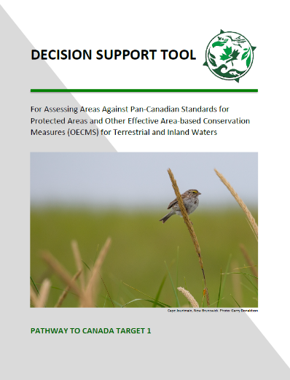
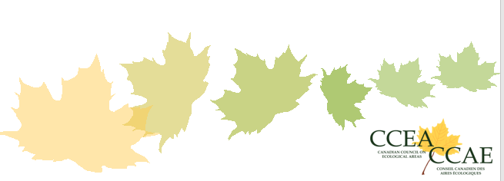
Introduction to the Decision Support Tool

Slide 2
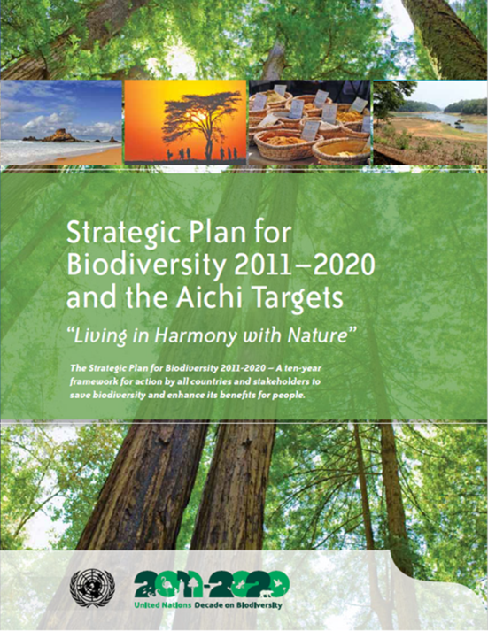
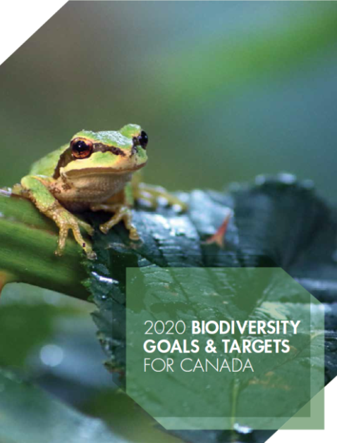
How did the DST come to be?
CBD Goal C: To improve the status of biodiversity by safeguarding ecosystems, species and genetic diversity
Aichi Target 11:…by 2020, at least 17% of lands and inland water and 10% of coastal and marine areas in networks of protected areas and “other effective area based conservation measures” … that are:
Ecologically representative
Include key areas for biodiversity
Include key areas for ecosystem services
Effectively and equitably managed
Well-connected and integrated into the broader landscape
Canada Target 1: “By 2020, at least 17 per cent of terrestrial areas and inland water, and 10 percent of coastal and marine areas, are conserved through networks of protected areas and other effective area-based conservation measures.”
Notes:
To fully understand where the DST came from and why we need one, we need to step back to look at the International and National targets. What we do in Canada and our individual jurisdictions ties back to the Convention on Biological Diversity, if which Canada (and some provinces – like Quebec) are a signatory.
The CBDs 2011-2020 Strategic Plan outlines 20 Targets, collectively known as the Aichi Targets. Aichi Target 11 is specific to conservation areas. It falls under the CBD goal C.
Aichi Target 11: “By 2020, at least 17 per cent of terrestrial and inland water, and 10 per cent of coastal and marine areas, especially areas of particular importance for biodiversity and ecosystem services, are conserved through effectively and equitably managed, ecologically representative and well connected systems of protected areas and other effective area-based conservation measures, and integrated into the wider landscapes and seascapes. ”
Canada Target 1: In 2015, Canada adopted a set of national biodiversity goals and targets for 2020 in response to the Aichi Targets. Canada Target 1 specifically parallels Aichi Target 11 in it’s area based target. Although the additional, qualitative elements of Aichi target 11 are not explicitly mentioned. implementation guidance that accompanies Target 1 acknowledges all of the qualifiers in Aichi Target 11 (e.g., ecologically representative, effectively managed, etc.), as the “guiding elements” of Canada Target 1.

Slide 3
How did the DST come to be?
CCEA (2012 – present)
Published draft tool and guidance May 2018
IUCN-WCPA Global Task Force on OECMs (2015 – present)
CBD Secretariat requested assistance from IUCN-WCPA in 2012
Task Force established in 2015
CBD accepted Task Force’s proposed definition and guidance with a few amendments November 2018
IUCN-WCPA final guidance
Pathway to Canada Target 1 (2017 – present)
One with Nature report interprets internationally agreed-to definitions for protected areas and OECMs in a way that is supportive of international guidance for these definitions within the Canadian context.
Pathway to Canada Target 1 and CCEA collaboration (2018 – present)
Revised draft CCEA tool based upon One with Nature report
Decision Support Tool For Assessing Areas Against Pan-Canadian Standards for Protected Areas and Other Effective Area-based Conservation Measures for Terrestrial and Inland Waters
Notes:
In 2011 – we all had a pretty good grasp on what protected areas were but OECMs were new. As such Initial work on developing screening tools was on identifying OECMs
The Pathway to Canada Target 1 decision-support tool and associated guidance is based on a tool originally developed and published by the Canadian Council on Ecological Areas (CCEA). The original CCEA tool has been collaboratively revised by Pathway jurisdictions, and members of the CCEA and Nature Conservancy of Canada to support jurisdictions in assessing if an area contributes to Target 1. Took the original CCEA tool and revised it to ensure it follows the guidance in the 2019 pan-Canadian One with Nature report. The One with Nature report interprets internationally agreed to definitions for protected areas and other conserved areas in a way that is supportive of international guidance for these definitions within the Canadian context.

Slide 4
Defining Protected Areas and OECMs
Protected Area
Other Effective Area-Based Conservation Measure
“A clearly defined geographical space, recognised, dedicated and managed, through legal or other effective means, to achieve the long-term conservation of nature with associated ecosystem services and cultural values.” (IUCN, Pathway)
“A geographically defined area other than a Protected Area, which is governed and managed in ways that achieve positive and sustained long-term outcomes for the in situ conservation of biodiversity, with associated ecosystem functions and services and where applicable, cultural, spiritual, socio–economic, and other locally relevant values” (IUCN / CBD, Pathway)
Notes:
As development of screening for OECMs advanced in Canada and at the IUCN it became apparent that they are both quite similar and have many of the same principles. This is why Canada’s DST is for both PAs and OECMs.
Lets looks a some of those core similarities and differences.

Slide 5
Key Common Principles of Protected Areas and OECMs
Clearly defined geographical spaces
Achieve the effective, long-term in-situ conservation of biodiversity
OECMs are comparable to protected areas in terms of biodiversity outcomes; OECMs are not less effective; not 2^{nd-class}
In-situ conservation of biodiversity means the conservation of ecosystems and natural habitats and the maintenance and recovery of viable populations of species in their natural surroundings.
Are “long-term” meaning that conservation is expected/likely to continue indefinitely, without an endpoint
Notes:
There are a few key principles that apply equally to PA and OECMs
The in-situ conservation of biodiversity is a really key term in all of this. It means The conservation of ecosystems and natural habitats and the maintenance and recovery of viable populations of species in their natural surroundings and, in the case of domesticated or cultivated species, in the surroundings where they have developed their distinctive properties. (CBD Article 2).

Slide 6
Key Difference between Protected Areas and OECMs
Protected Area
Other Effective Area-Based Conservation Measure
Objectives for biodiversity conservation are primary and over-riding
May or may not have conservation of biodiversity objectives, but objectives must exist, and they must be consistent and not in conflict, whether intentionally or otherwise, with the in-situ conservation of biodiversity
Notes:
There are other nuanced differences between PAs and OECMs as you will see as we move into looking at the DST in more detail. However, there is once CORE difference and that is objectives.
OECM - May not have the conservation of biodiversity as the primary goal, yet are managed over the long-term in ways that result in the effective and enduring protection of biodiversity
PAs and OECMs are mutually exclusive – an area can be one, or the other, or neither, but not both
IPCAs may meet PA criteria, or OECM criteria, or neither

Slide 7
What is the DST for?
Determining if conservation areas meet the Canada Target 1 reporting criteria
Reporting is at the discretion of the jurisdictions and relevant primary governing authorities.
Differentiating between protected areas and other effective area-based conservation measures (OECMs)
Ensuring a national standard for reporting to CPCAD for areas under all governance authorities
Can be used to:
ensure that a new site is meeting the criteria during the planning phase
screen existing sites not currently being accounted for in CPCAD
Identify gaps in candidate sites
Notes:
Reporting is at the discretion of the jurisdictions (final decisions on what areas satisfy the criteria and can be reported) and relevant primary governing authorities (must consent to their areas being reported).
Pathway to Canada Target 1 decision support tool has been designed to promote consistency and transparency when identifying and reporting contributing areas for terrestrial and inland waters.
Areas that meet the criteria can then be reported to the Canadian Protected and Conserved Areas Database (CPCAD), which in turn supports reporting at the national and international levels.
Want to be able to account for all PAs and OECMs under all governance authorities. Within the FPT governments we have lots of experience accounting for protected areas and we are quite clear on what meets the criteria of a PA. However other governing authorities (i..e private land trusts, Indigenous governments) do not have much experience yet with ensuring that their “protected areas” meet the critieria or maybe they are just unsure. OECMs are new for all of us, and within the FTP governments this is bringing in different land managers so this tool is useful to help us ensure that the sites we are reporting now or want to report in future are actually meeting the criteria of a protected area
Can be used to:
ensure that a new site is meeting the criteria during the planning phase
screen existing sites not currently being accounted for in CPCAD to see if they meet the criteria
Identify gaps in candidate areas such that those gaps can be addressed so sites can achieve PA or OECM standard and be accounted for
Criteria = PA and OECM criteria

